Slide 1
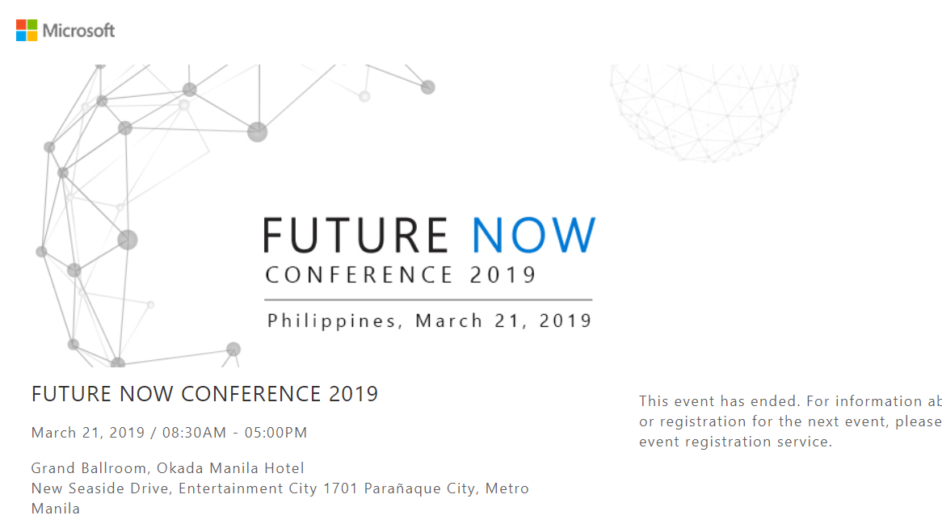

Slide 2
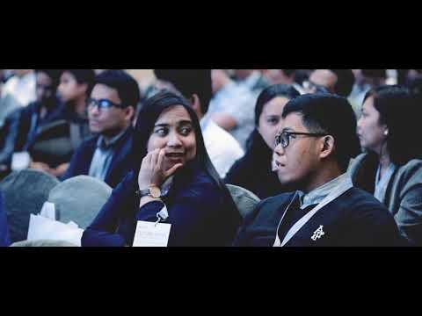

Slide 3
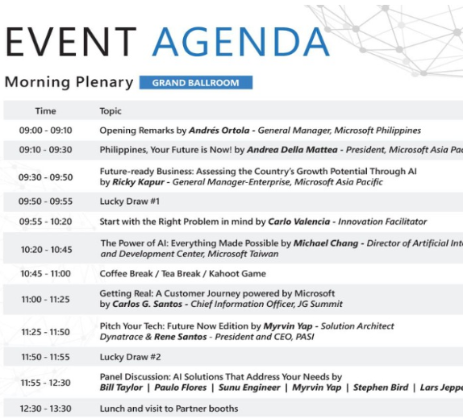

Slide 4
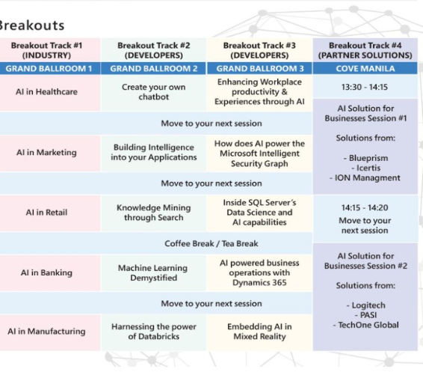

Slide 5

Key Takeaways
Morning Session
- Better understanding of how Design Thinking Works (End-to-End process discussion)
- Knowledge on the possible impacts of AI implementation in the Philippine setting
- Idea on how MS products are implemented in MS partners

Slide 6

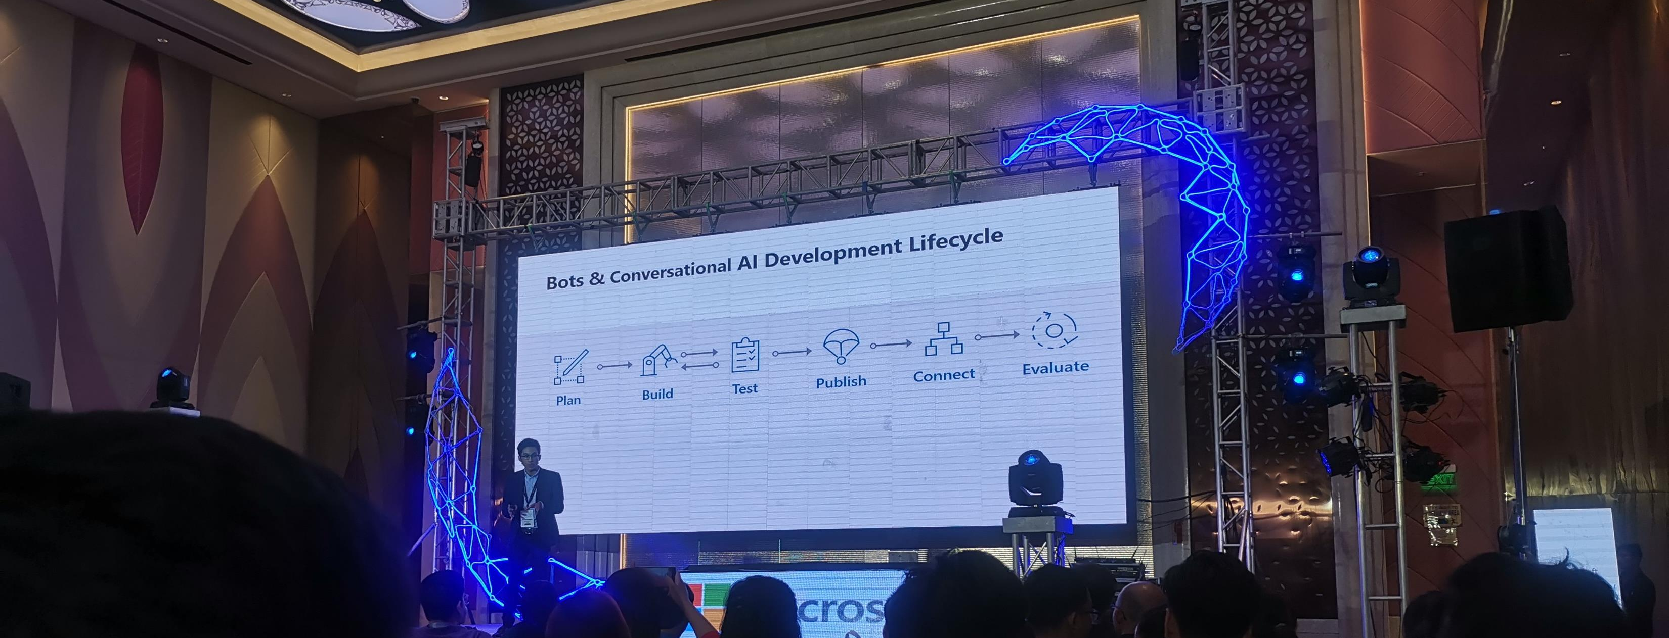
Key Takeaways
Afternoon Session
- Introduction to Azure Chatbot creation

Slide 7
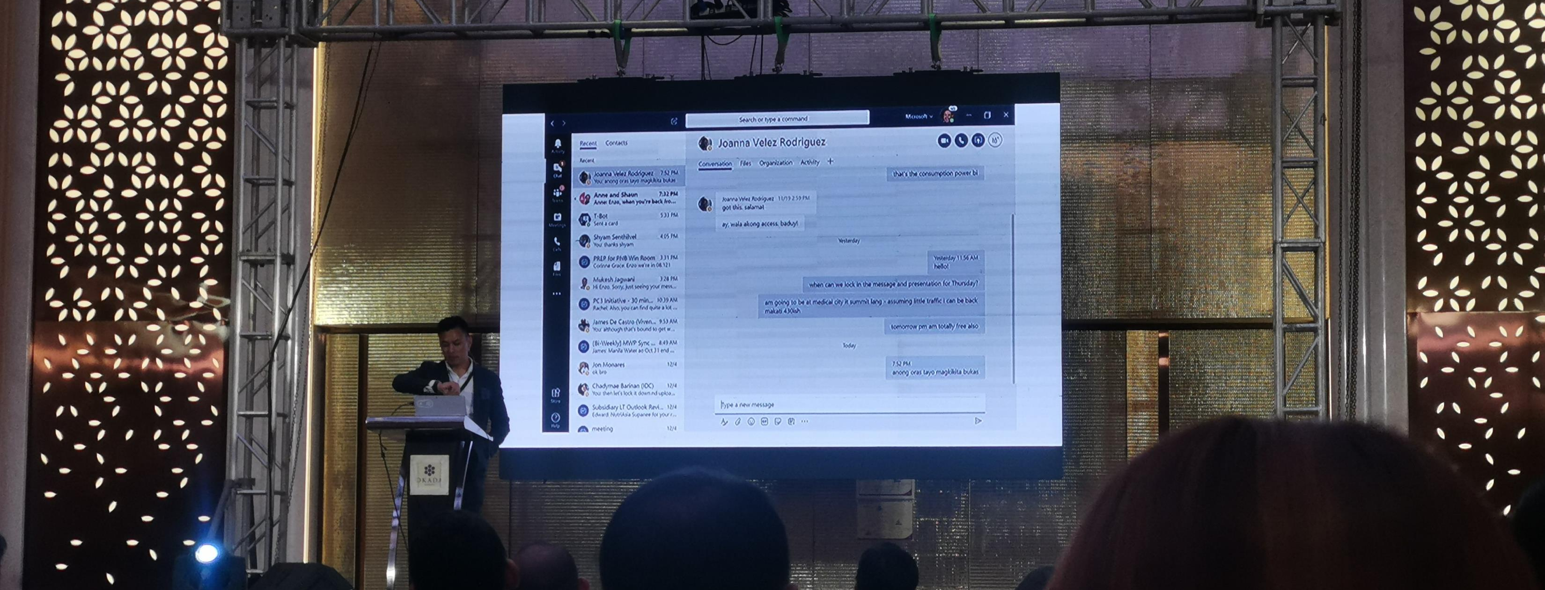
Key Takeaways
Afternoon Session
- MS products that can enhance Workplace Productivity and Experience (thru Teams and Powerpoint AI)

Slide 8
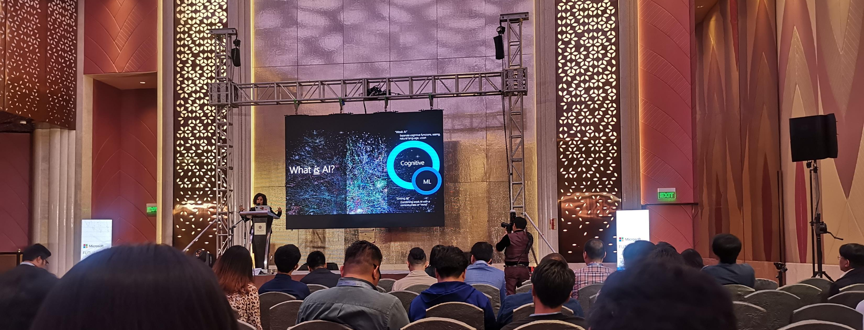
Key Takeaways
Afternoon Session
- Basic Azure Machine Learning

Slide 9

Thank you!

